Slide 1
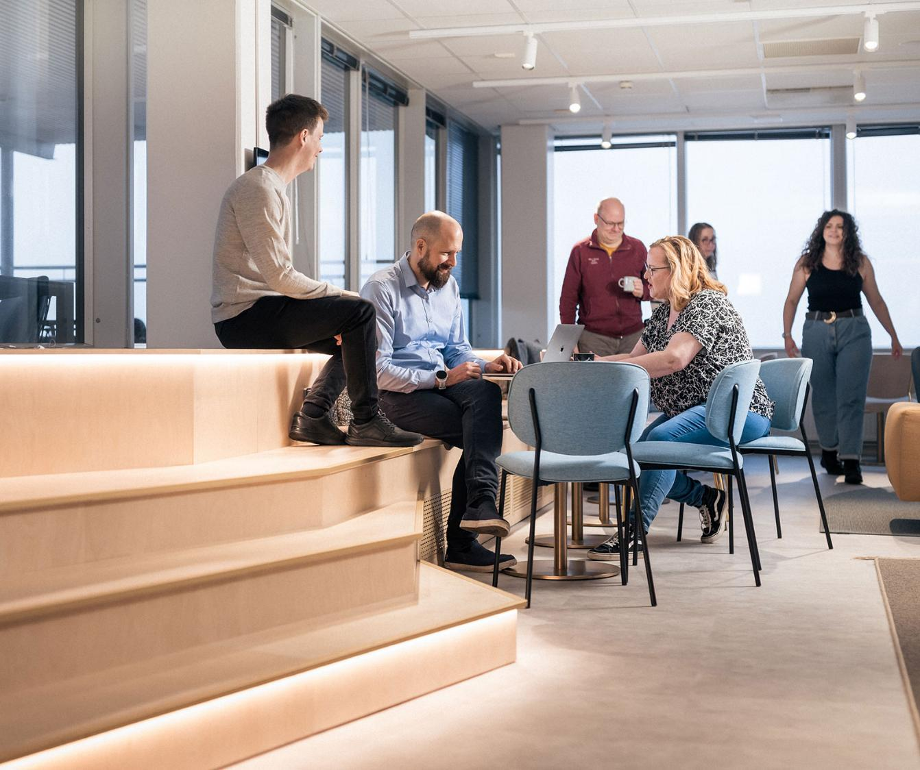
Using Lumi-O to migrate data from Puhti and Mahti to Roihu
3. 6 2026

Slide 2
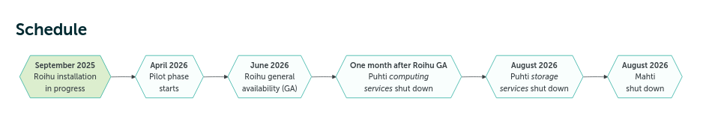
Schedule for data migration to Roihu
Current plan is that Roihu will be opened for general use in the beginning of July
Puhti and Mahti will be closed in the end of August
Data, that needs to be preserved must be copied from Puhti and Mahti before end of August.
Notes:
Finnish state owns 70% of CSC and Finnish higher education institutions own 30%. Companies entrusted with special state assignments are companies owned either partly or completely by the state, and in which the state has special interests regarding regulation or official duties; the company on its behalf has an assignment defined by the state. As part of national research system CSC develops, integrates and provides high-quality information technology services and ensures that Finland remains at the forefront of development.​
​
As a non-profit state enterprise with special tasks, the foundation for our existence is to create value for our customers. We catalyze our customers’ success by helping them to compute, preserve, transfer, analyze, and utilize information. Our owners determine the purpose of the enterprise and a majority of our services are aimed at meeting our owners' needs. ​
​
Our primary customers are the Ministry of Education and Culture and organizations in the field, higher education institutions (universities and universities of applied sciences), research institutes and public administration. Our owners are able to purchase our services without bidding and we provide services to our owners for no profit. As a non-profit enterprise we do not seek financial profit, and our success is measured in terms of how much value it generates for our owners and customers.​
​
We provide internationally high-quality ICT services for our customers, such as:​
Computing and data management services for researchers​
Digital learning and education services for education organizations​
Common platforms, identity management services and network for public administration and culture.​
​
CSC´s datacenter has operated in Kajaani since 2012. Our data center ecosystem includes Finland’s national computing resources Puhti and Mahti supercomputers and Allas, which is a data management system. In addition, EuroHPC’s, that is, EU’s supercomputing joint undertaking’s LUMI, which is one of the world’s fastest and ecofriendliest supercomputers, is also located in our Kajaani data center. The data center’s carbon footprint is minimized: for instance Kajaani’s geographical location provides excellent conditions for cooling down servers with outdoor air. LUMI’s excess heat is also reused in Kajaani district heating. ​

Slide 3
Disk areas in Roihu
Roihu will have /scratch and /projappl disk areas just like Puht and Mahti, but note that if you are using extended quotas in Puhti or Mahti, the quotas are not inherited by Roihu.
In MyCSC, Projects can increase scratch quota from the default 250 GiB/0,5 M files up to 10 TiB/ 2.5 M fliles.
If your project needs a larger quota you need to apply for it after you have added Roihu access to your profile.
Roihu users can also apply for separate dataset projects, which provide access to shared disk area under /projdata/project, but no computational resources. These projects are designed for sharing data between multiple projects.
Notes:
Finnish state owns 70% of CSC and Finnish higher education institutions own 30%. Companies entrusted with special state assignments are companies owned either partly or completely by the state, and in which the state has special interests regarding regulation or official duties; the company on its behalf has an assignment defined by the state. As part of national research system CSC develops, integrates and provides high-quality information technology services and ensures that Finland remains at the forefront of development.​
​
As a non-profit state enterprise with special tasks, the foundation for our existence is to create value for our customers. We catalyze our customers’ success by helping them to compute, preserve, transfer, analyze, and utilize information. Our owners determine the purpose of the enterprise and a majority of our services are aimed at meeting our owners' needs. ​
​
Our primary customers are the Ministry of Education and Culture and organizations in the field, higher education institutions (universities and universities of applied sciences), research institutes and public administration. Our owners are able to purchase our services without bidding and we provide services to our owners for no profit. As a non-profit enterprise we do not seek financial profit, and our success is measured in terms of how much value it generates for our owners and customers.​
​
We provide internationally high-quality ICT services for our customers, such as:​
Computing and data management services for researchers​
Digital learning and education services for education organizations​
Common platforms, identity management services and network for public administration and culture.​
​
CSC´s datacenter has operated in Kajaani since 2012. Our data center ecosystem includes Finland’s national computing resources Puhti and Mahti supercomputers and Allas, which is a data management system. In addition, EuroHPC’s, that is, EU’s supercomputing joint undertaking’s LUMI, which is one of the world’s fastest and ecofriendliest supercomputers, is also located in our Kajaani data center. The data center’s carbon footprint is minimized: for instance Kajaani’s geographical location provides excellent conditions for cooling down servers with outdoor air. LUMI’s excess heat is also reused in Kajaani district heating. ​

Slide 4
Roihu and Allas
Allas is not affected by removal of Puhti and Mahti
You will be able to use Allas from Roihu, but the default Allas protocol will change from Swift to S3 (we will have a separate short talk on that once Roihu is available)
Problem: Allas is at the moment very full: Only small quota a extensions can be granted before the end of the year.
Direct Rsync will be the recommended data migration method.
You should use Allas to migrate only moderate size datasets (total data mass less than 1-2 TiB/ project).
Notes:
Finnish state owns 70% of CSC and Finnish higher education institutions own 30%. Companies entrusted with special state assignments are companies owned either partly or completely by the state, and in which the state has special interests regarding regulation or official duties; the company on its behalf has an assignment defined by the state. As part of national research system CSC develops, integrates and provides high-quality information technology services and ensures that Finland remains at the forefront of development.​
​
As a non-profit state enterprise with special tasks, the foundation for our existence is to create value for our customers. We catalyze our customers’ success by helping them to compute, preserve, transfer, analyze, and utilize information. Our owners determine the purpose of the enterprise and a majority of our services are aimed at meeting our owners' needs. ​
​
Our primary customers are the Ministry of Education and Culture and organizations in the field, higher education institutions (universities and universities of applied sciences), research institutes and public administration. Our owners are able to purchase our services without bidding and we provide services to our owners for no profit. As a non-profit enterprise we do not seek financial profit, and our success is measured in terms of how much value it generates for our owners and customers.​
​
We provide internationally high-quality ICT services for our customers, such as:​
Computing and data management services for researchers​
Digital learning and education services for education organizations​
Common platforms, identity management services and network for public administration and culture.​
​
CSC´s datacenter has operated in Kajaani since 2012. Our data center ecosystem includes Finland’s national computing resources Puhti and Mahti supercomputers and Allas, which is a data management system. In addition, EuroHPC’s, that is, EU’s supercomputing joint undertaking’s LUMI, which is one of the world’s fastest and ecofriendliest supercomputers, is also located in our Kajaani data center. The data center’s carbon footprint is minimized: for instance Kajaani’s geographical location provides excellent conditions for cooling down servers with outdoor air. LUMI’s excess heat is also reused in Kajaani district heating. ​

Slide 5
Using Lumi-O to migrate or backup data from Puhti and Mahti
Lumi-O is the object storage system serving the Lumi computing services.
Usage resembles using Allas with S3 protocol in command line.
The usage politics is different
1. Needs a Lumi-O project ( Lumi-O service can’t be added to CSC projects)
2. Duration of the project is limited: 1 year + max. 2 year extension
3. Default storage quota is 150 TiB but in addition you have to apply all the storage billing units your storage project will need.
Notes:
Finnish state owns 70% of CSC and Finnish higher education institutions own 30%. Companies entrusted with special state assignments are companies owned either partly or completely by the state, and in which the state has special interests regarding regulation or official duties; the company on its behalf has an assignment defined by the state. As part of national research system CSC develops, integrates and provides high-quality information technology services and ensures that Finland remains at the forefront of development.​
​
As a non-profit state enterprise with special tasks, the foundation for our existence is to create value for our customers. We catalyze our customers’ success by helping them to compute, preserve, transfer, analyze, and utilize information. Our owners determine the purpose of the enterprise and a majority of our services are aimed at meeting our owners' needs. ​
​
Our primary customers are the Ministry of Education and Culture and organizations in the field, higher education institutions (universities and universities of applied sciences), research institutes and public administration. Our owners are able to purchase our services without bidding and we provide services to our owners for no profit. As a non-profit enterprise we do not seek financial profit, and our success is measured in terms of how much value it generates for our owners and customers.​
​
We provide internationally high-quality ICT services for our customers, such as:​
Computing and data management services for researchers​
Digital learning and education services for education organizations​
Common platforms, identity management services and network for public administration and culture.​
​
CSC´s datacenter has operated in Kajaani since 2012. Our data center ecosystem includes Finland’s national computing resources Puhti and Mahti supercomputers and Allas, which is a data management system. In addition, EuroHPC’s, that is, EU’s supercomputing joint undertaking’s LUMI, which is one of the world’s fastest and ecofriendliest supercomputers, is also located in our Kajaani data center. The data center’s carbon footprint is minimized: for instance Kajaani’s geographical location provides excellent conditions for cooling down servers with outdoor air. LUMI’s excess heat is also reused in Kajaani district heating. ​

Slide 6
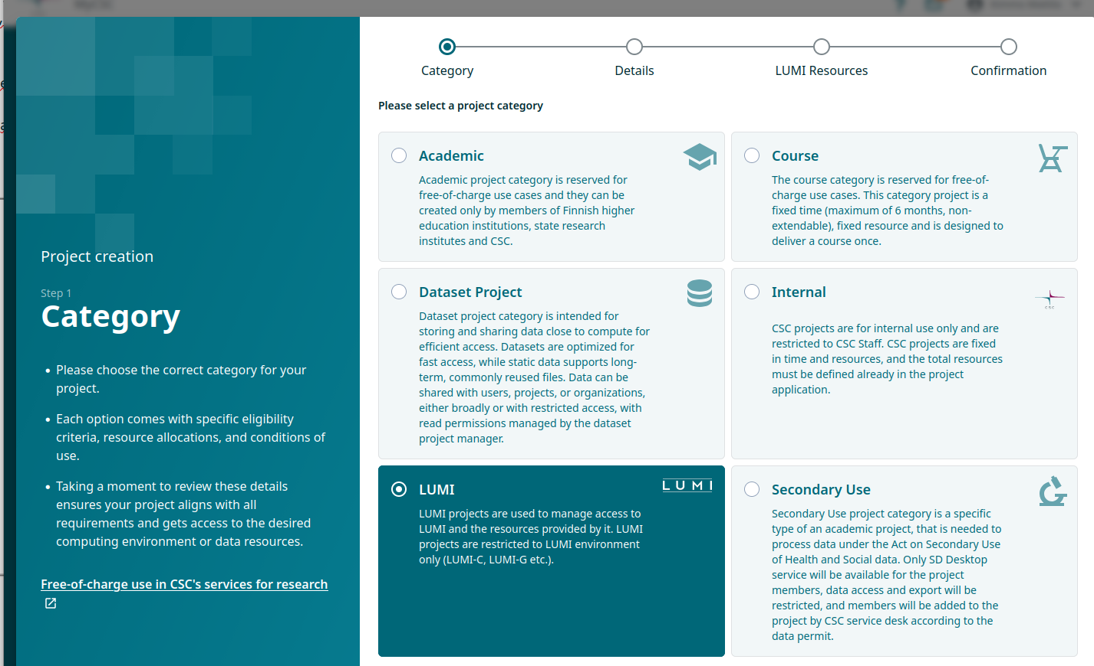
Lumi-O is the object storage system serving the Lumi comoputing services
Usage resembles using Allas with S3 protocol in command line usage.
The usage politics is different
1. Needs a Lumi-O project ( Lumi-O service can’t be added to CSC projects)
2. Duaration of the project is limited: 1 year + max. 2 year extension
3. Deafuaut storage quota is 150 TiB but in addition you have to apply all the storage billing units your storage porcess will need.
Create a Lumi-O project: Lumi project category
Login to MyCSC and start creating a new Lumi project
Notes:
Finnish state owns 70% of CSC and Finnish higher education institutions own 30%. Companies entrusted with special state assignments are companies owned either partly or completely by the state, and in which the state has special interests regarding regulation or official duties; the company on its behalf has an assignment defined by the state. As part of national research system CSC develops, integrates and provides high-quality information technology services and ensures that Finland remains at the forefront of development.​
​
As a non-profit state enterprise with special tasks, the foundation for our existence is to create value for our customers. We catalyze our customers’ success by helping them to compute, preserve, transfer, analyze, and utilize information. Our owners determine the purpose of the enterprise and a majority of our services are aimed at meeting our owners' needs. ​
​
Our primary customers are the Ministry of Education and Culture and organizations in the field, higher education institutions (universities and universities of applied sciences), research institutes and public administration. Our owners are able to purchase our services without bidding and we provide services to our owners for no profit. As a non-profit enterprise we do not seek financial profit, and our success is measured in terms of how much value it generates for our owners and customers.​
​
We provide internationally high-quality ICT services for our customers, such as:​
Computing and data management services for researchers​
Digital learning and education services for education organizations​
Common platforms, identity management services and network for public administration and culture.​
​
CSC´s datacenter has operated in Kajaani since 2012. Our data center ecosystem includes Finland’s national computing resources Puhti and Mahti supercomputers and Allas, which is a data management system. In addition, EuroHPC’s, that is, EU’s supercomputing joint undertaking’s LUMI, which is one of the world’s fastest and ecofriendliest supercomputers, is also located in our Kajaani data center. The data center’s carbon footprint is minimized: for instance Kajaani’s geographical location provides excellent conditions for cooling down servers with outdoor air. LUMI’s excess heat is also reused in Kajaani district heating. ​

Slide 7
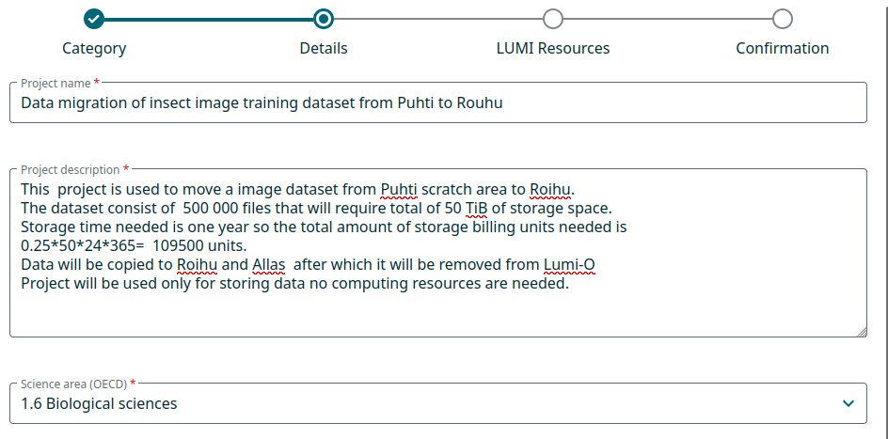
Lumi-O is the object storage system serving the Lumi comoputing services
Usage resembles using Allas with S3 protocol in command line usage.
The usage politics is different
1. Needs a Lumi-O project ( Lumi-O service can’t be added to CSC projects)
2. Duaration of the project is limited: 1 year + max. 2 year extension
3. Deafuaut storage quota is 150 TiB but in addition you have to apply all the storage billing units your storage porcess will need.
Create a Lumi-O project: Description
In the project description, mention that this project will used only Lumi-O service.
Describe shortly the dataset and calculate the amount of TiB hours that your project will use.
Notes:
Finnish state owns 70% of CSC and Finnish higher education institutions own 30%. Companies entrusted with special state assignments are companies owned either partly or completely by the state, and in which the state has special interests regarding regulation or official duties; the company on its behalf has an assignment defined by the state. As part of national research system CSC develops, integrates and provides high-quality information technology services and ensures that Finland remains at the forefront of development.​
​
As a non-profit state enterprise with special tasks, the foundation for our existence is to create value for our customers. We catalyze our customers’ success by helping them to compute, preserve, transfer, analyze, and utilize information. Our owners determine the purpose of the enterprise and a majority of our services are aimed at meeting our owners' needs. ​
​
Our primary customers are the Ministry of Education and Culture and organizations in the field, higher education institutions (universities and universities of applied sciences), research institutes and public administration. Our owners are able to purchase our services without bidding and we provide services to our owners for no profit. As a non-profit enterprise we do not seek financial profit, and our success is measured in terms of how much value it generates for our owners and customers.​
​
We provide internationally high-quality ICT services for our customers, such as:​
Computing and data management services for researchers​
Digital learning and education services for education organizations​
Common platforms, identity management services and network for public administration and culture.​
​
CSC´s datacenter has operated in Kajaani since 2012. Our data center ecosystem includes Finland’s national computing resources Puhti and Mahti supercomputers and Allas, which is a data management system. In addition, EuroHPC’s, that is, EU’s supercomputing joint undertaking’s LUMI, which is one of the world’s fastest and ecofriendliest supercomputers, is also located in our Kajaani data center. The data center’s carbon footprint is minimized: for instance Kajaani’s geographical location provides excellent conditions for cooling down servers with outdoor air. LUMI’s excess heat is also reused in Kajaani district heating. ​

Slide 8

Lumi-O is the object storage system serving the Lumi comoputing services
Usage resembles using Allas with S3 protocol in command line usage.
The usage politics is different
1. Needs a Lumi-O project ( Lumi-O service can’t be added to CSC projects)
2. Duaration of the project is limited: 1 year + max. 2 year extension
3. Deafuaut storage quota is 150 TiB but in addition you have to apply all the storage billing units your storage porcess will need.
Create a Lumi-O project: Access mode
We don’t yet have a specific project type for Lumi-O.
Use Benchmark project type instead.
Notes:
Finnish state owns 70% of CSC and Finnish higher education institutions own 30%. Companies entrusted with special state assignments are companies owned either partly or completely by the state, and in which the state has special interests regarding regulation or official duties; the company on its behalf has an assignment defined by the state. As part of national research system CSC develops, integrates and provides high-quality information technology services and ensures that Finland remains at the forefront of development.​
​
As a non-profit state enterprise with special tasks, the foundation for our existence is to create value for our customers. We catalyze our customers’ success by helping them to compute, preserve, transfer, analyze, and utilize information. Our owners determine the purpose of the enterprise and a majority of our services are aimed at meeting our owners' needs. ​
​
Our primary customers are the Ministry of Education and Culture and organizations in the field, higher education institutions (universities and universities of applied sciences), research institutes and public administration. Our owners are able to purchase our services without bidding and we provide services to our owners for no profit. As a non-profit enterprise we do not seek financial profit, and our success is measured in terms of how much value it generates for our owners and customers.​
​
We provide internationally high-quality ICT services for our customers, such as:​
Computing and data management services for researchers​
Digital learning and education services for education organizations​
Common platforms, identity management services and network for public administration and culture.​
​
CSC´s datacenter has operated in Kajaani since 2012. Our data center ecosystem includes Finland’s national computing resources Puhti and Mahti supercomputers and Allas, which is a data management system. In addition, EuroHPC’s, that is, EU’s supercomputing joint undertaking’s LUMI, which is one of the world’s fastest and ecofriendliest supercomputers, is also located in our Kajaani data center. The data center’s carbon footprint is minimized: for instance Kajaani’s geographical location provides excellent conditions for cooling down servers with outdoor air. LUMI’s excess heat is also reused in Kajaani district heating. ​

Slide 9
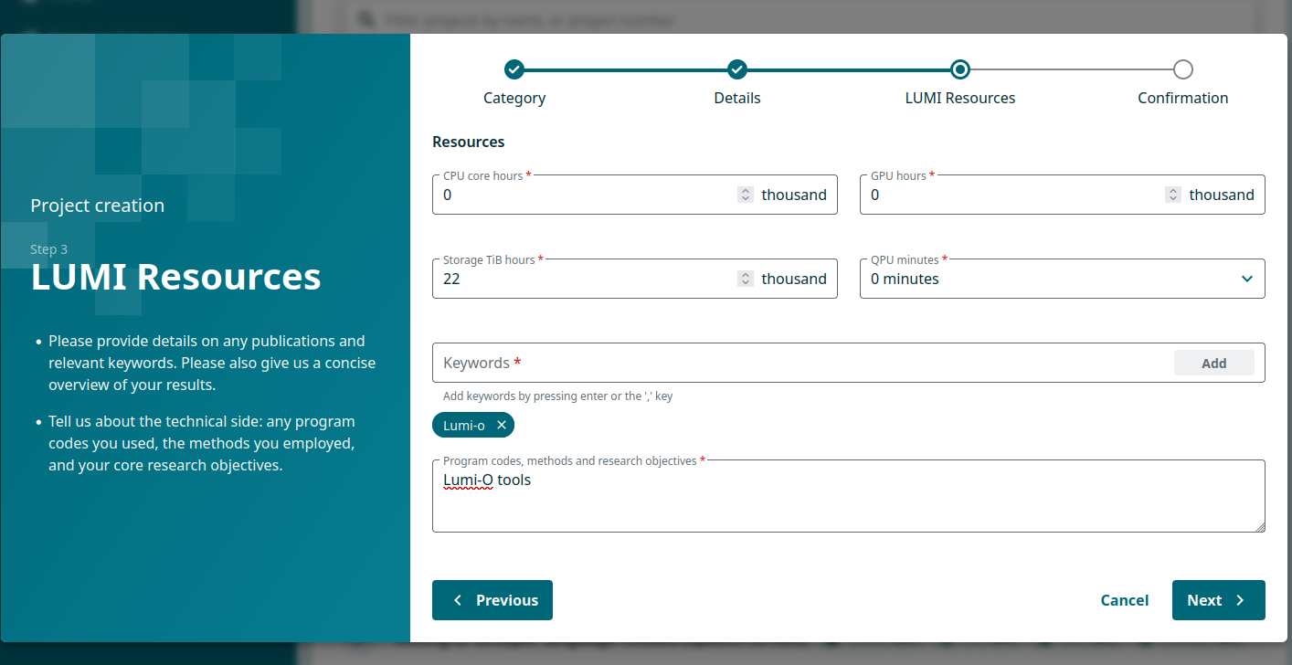
Lumi-O is the object storage system serving the Lumi comoputing services
Usage resembles using Allas with S3 protocol in command line usage.
The usage politics is different
1. Needs a Lumi-O project ( Lumi-O service can’t be added to CSC projects)
2. Duaration of the project is limited: 1 year + max. 2 year extension
3. Deafuaut storage quota is 150 TiB but in addition you have to apply all the storage billing units your storage porcess will need.
Create a Lumi-O project: Resources
Normal Bechmark projects can have only 22 000 TiB hours allocated.
Fill the resource requiest using that value.
CSC will replace the value later on based on the resource usage calculation that you added to the project description.
Notes:
Finnish state owns 70% of CSC and Finnish higher education institutions own 30%. Companies entrusted with special state assignments are companies owned either partly or completely by the state, and in which the state has special interests regarding regulation or official duties; the company on its behalf has an assignment defined by the state. As part of national research system CSC develops, integrates and provides high-quality information technology services and ensures that Finland remains at the forefront of development.​
​
As a non-profit state enterprise with special tasks, the foundation for our existence is to create value for our customers. We catalyze our customers’ success by helping them to compute, preserve, transfer, analyze, and utilize information. Our owners determine the purpose of the enterprise and a majority of our services are aimed at meeting our owners' needs. ​
​
Our primary customers are the Ministry of Education and Culture and organizations in the field, higher education institutions (universities and universities of applied sciences), research institutes and public administration. Our owners are able to purchase our services without bidding and we provide services to our owners for no profit. As a non-profit enterprise we do not seek financial profit, and our success is measured in terms of how much value it generates for our owners and customers.​
​
We provide internationally high-quality ICT services for our customers, such as:​
Computing and data management services for researchers​
Digital learning and education services for education organizations​
Common platforms, identity management services and network for public administration and culture.​
​
CSC´s datacenter has operated in Kajaani since 2012. Our data center ecosystem includes Finland’s national computing resources Puhti and Mahti supercomputers and Allas, which is a data management system. In addition, EuroHPC’s, that is, EU’s supercomputing joint undertaking’s LUMI, which is one of the world’s fastest and ecofriendliest supercomputers, is also located in our Kajaani data center. The data center’s carbon footprint is minimized: for instance Kajaani’s geographical location provides excellent conditions for cooling down servers with outdoor air. LUMI’s excess heat is also reused in Kajaani district heating. ​

Slide 10
Using Lumi-O from Puhti and Mahti
Setup commands:
module laod allas
allas-conf --lumi
The configuration process asks you to connect with your browser to LUMI-O configuration sever, create credentials there and then copy the project number and keys for the setup tool.
Notes:
Finnish state owns 70% of CSC and Finnish higher education institutions own 30%. Companies entrusted with special state assignments are companies owned either partly or completely by the state, and in which the state has special interests regarding regulation or official duties; the company on its behalf has an assignment defined by the state. As part of national research system CSC develops, integrates and provides high-quality information technology services and ensures that Finland remains at the forefront of development.​
​
As a non-profit state enterprise with special tasks, the foundation for our existence is to create value for our customers. We catalyze our customers’ success by helping them to compute, preserve, transfer, analyze, and utilize information. Our owners determine the purpose of the enterprise and a majority of our services are aimed at meeting our owners' needs. ​
​
Our primary customers are the Ministry of Education and Culture and organizations in the field, higher education institutions (universities and universities of applied sciences), research institutes and public administration. Our owners are able to purchase our services without bidding and we provide services to our owners for no profit. As a non-profit enterprise we do not seek financial profit, and our success is measured in terms of how much value it generates for our owners and customers.​
​
We provide internationally high-quality ICT services for our customers, such as:​
Computing and data management services for researchers​
Digital learning and education services for education organizations​
Common platforms, identity management services and network for public administration and culture.​
​
CSC´s datacenter has operated in Kajaani since 2012. Our data center ecosystem includes Finland’s national computing resources Puhti and Mahti supercomputers and Allas, which is a data management system. In addition, EuroHPC’s, that is, EU’s supercomputing joint undertaking’s LUMI, which is one of the world’s fastest and ecofriendliest supercomputers, is also located in our Kajaani data center. The data center’s carbon footprint is minimized: for instance Kajaani’s geographical location provides excellent conditions for cooling down servers with outdoor air. LUMI’s excess heat is also reused in Kajaani district heating. ​

Slide 11
Lumi-O is the object storage system serving the Lumi comoputing services
Usage resembles using Allas with S3 protocol in command line usage.
The usage politics is different
1. Needs a Lumi-O project ( Lumi-O service can’t be added to CSC projects)
2. Duaration of the project is limited: 1 year + max. 2 year extension
3. Deafuaut storage quota is 150 TiB but in addition you have to apply all the storage billing units your storage porcess will need.
Using Lumi-O from Puhti and Mahti
The setup process for LUMI-O will create configuration files for s3cmd and rclone.
During configuration you can choose that a-commands will use by default LUMI-O. Alternatively you can add option --lumi to a-commands.
a-list --lumi
Rclone can use Lumi-O with endpoint: lumi-o
rclone lsd lumi-o:
Notes:
Finnish state owns 70% of CSC and Finnish higher education institutions own 30%. Companies entrusted with special state assignments are companies owned either partly or completely by the state, and in which the state has special interests regarding regulation or official duties; the company on its behalf has an assignment defined by the state. As part of national research system CSC develops, integrates and provides high-quality information technology services and ensures that Finland remains at the forefront of development.​
​
As a non-profit state enterprise with special tasks, the foundation for our existence is to create value for our customers. We catalyze our customers’ success by helping them to compute, preserve, transfer, analyze, and utilize information. Our owners determine the purpose of the enterprise and a majority of our services are aimed at meeting our owners' needs. ​
​
Our primary customers are the Ministry of Education and Culture and organizations in the field, higher education institutions (universities and universities of applied sciences), research institutes and public administration. Our owners are able to purchase our services without bidding and we provide services to our owners for no profit. As a non-profit enterprise we do not seek financial profit, and our success is measured in terms of how much value it generates for our owners and customers.​
​
We provide internationally high-quality ICT services for our customers, such as:​
Computing and data management services for researchers​
Digital learning and education services for education organizations​
Common platforms, identity management services and network for public administration and culture.​
​
CSC´s datacenter has operated in Kajaani since 2012. Our data center ecosystem includes Finland’s national computing resources Puhti and Mahti supercomputers and Allas, which is a data management system. In addition, EuroHPC’s, that is, EU’s supercomputing joint undertaking’s LUMI, which is one of the world’s fastest and ecofriendliest supercomputers, is also located in our Kajaani data center. The data center’s carbon footprint is minimized: for instance Kajaani’s geographical location provides excellent conditions for cooling down servers with outdoor air. LUMI’s excess heat is also reused in Kajaani district heating. ​

