Slide 1
LUMI world-class supercomputer
CSC coffee break – 1.3.2023 – Emmanuel Ory

Slide 2
LUMI – a unique joint endeavor in high-performance computing
The resources of LUMI are allocated per EuroHPC JU and the consortium countries investments
The share of Finland (25%) will be allocated through a resource allocation administrative process and available for all researchers from Finland
The share of the EuroHPC JU (50%) will be allocated through a peer-review process and available for all researchers from EuroHPC JU member states

Slide 3
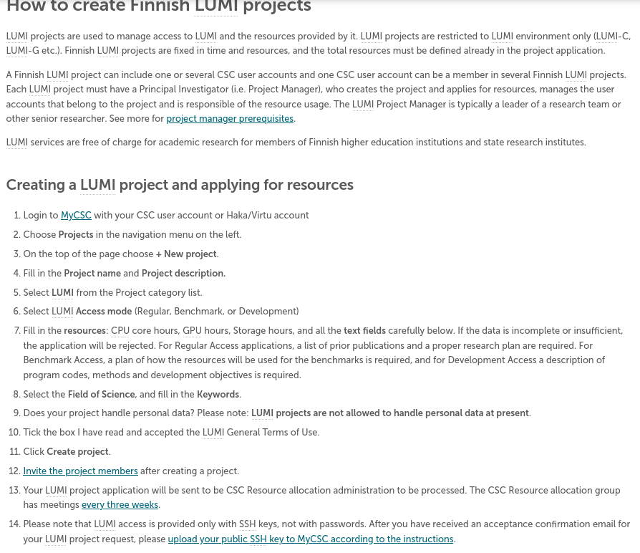
CSC - LUMI Access mode (Regular, Benchmark, or Development)
LUMI project application is sent to the CSC resource allocation administration to be processed (meetings every 3 weeks)
Specific calls for extreme scale projects
https://docs.csc.fi/accounts/how-to-create-new-project/#how-to-create-finnish-lumi-projects

Slide 4
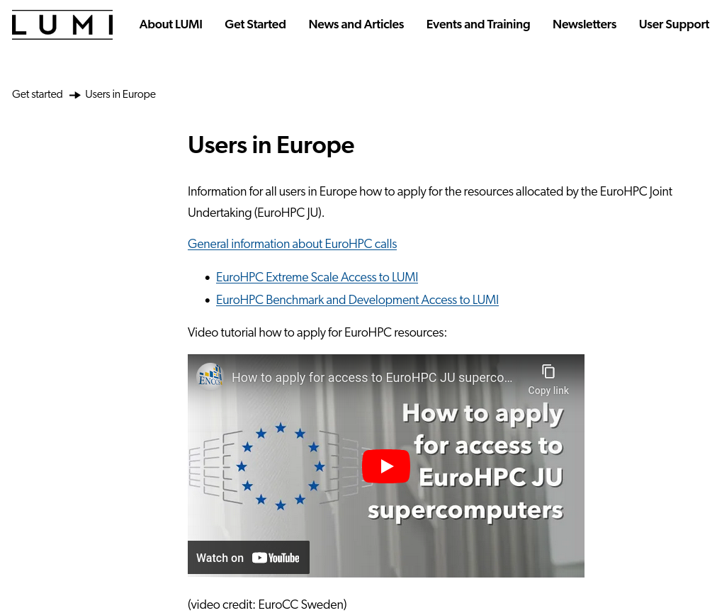
How to apply for the resources allocated by EuroHPC JU
https://www.lumi-supercomputer.eu/get-started-2021/users-in-europe/

Slide 5
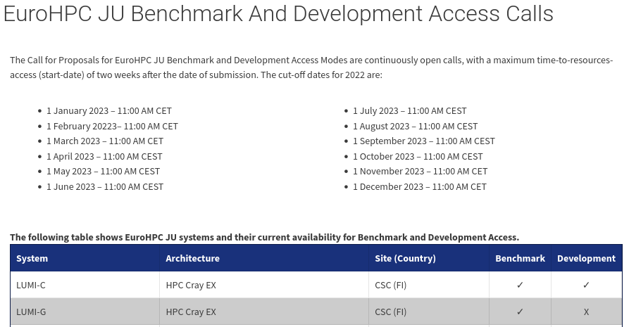
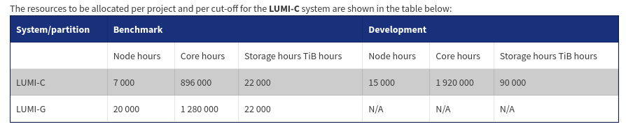
EuroHPC JU Benchmark and Development Access Calls
https://prace-ri.eu/hpc-access/eurohpc-access/eurohpc-ju-benchmark-development-access-calls/
https://prace-ri.eu/hpc-access/eurohpc-access/eurohpc-ju-benchmark-development-access-calls/benchmark-development-applicant-information/

Slide 6
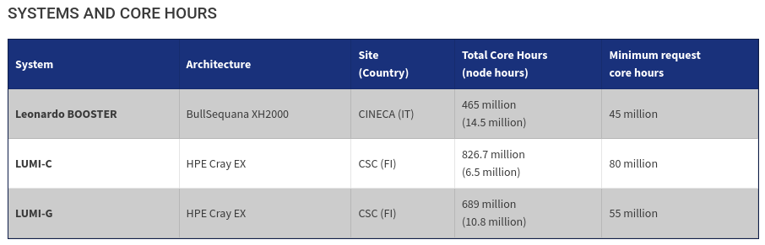
EuroHPC JU Extreme Scale Access Calls
Beware LUMI-G minimum request (core hours ≠ node hours)
https://prace-ri.eu/call/eurohpc-extreme-scale-access-2023-04-28/

Slide 7
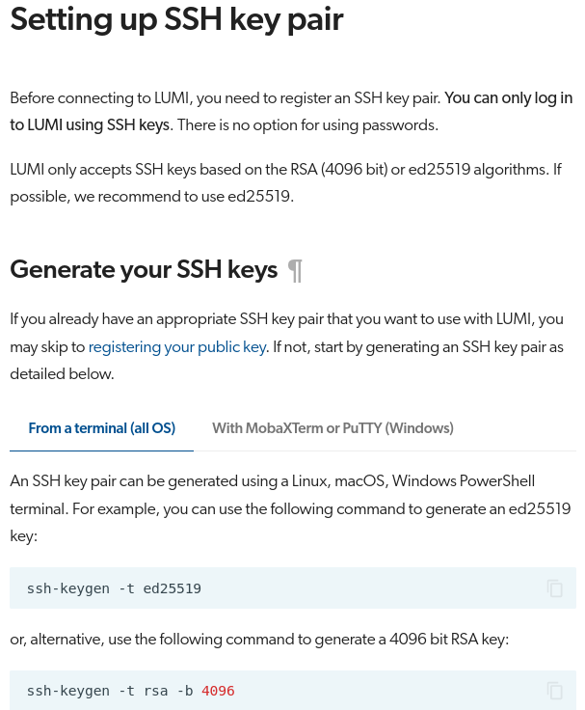
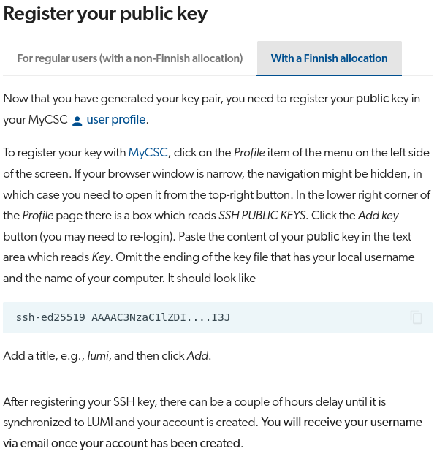
Finnish allocation vs EuroHPC allocation vs training projects
Finnish allocation: myCSC
EuroHPC allocation: https://my.lumi-supercomputer.eu/
LUST/CoE training projects: Puhuri
Before connecting to LUMI, you need to register an SSH key pair. You can only log in to LUMI using SSH keys. There is no option for using passwords: https://docs.lumi-supercomputer.eu/firststeps/SSH-keys/

Slide 8
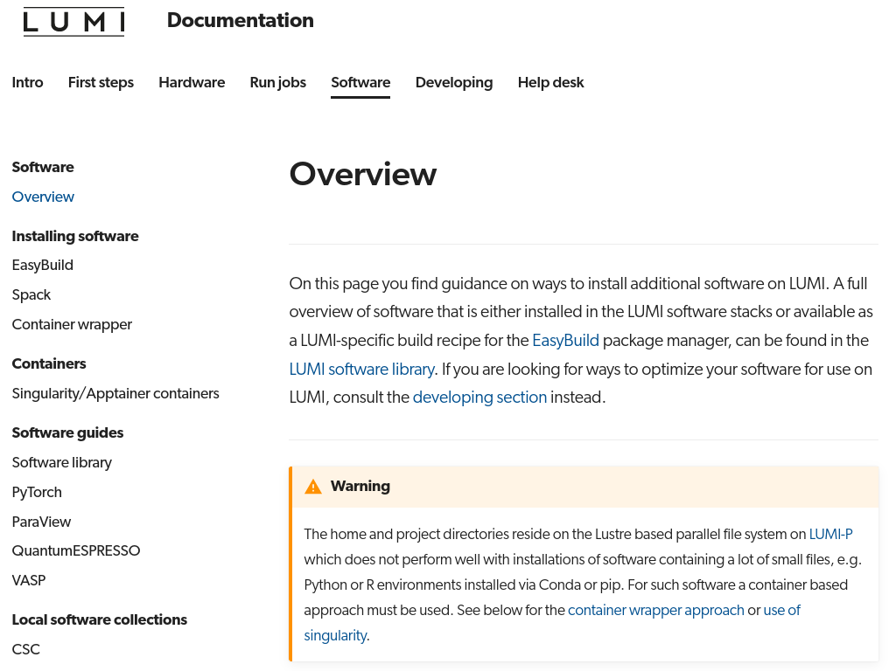
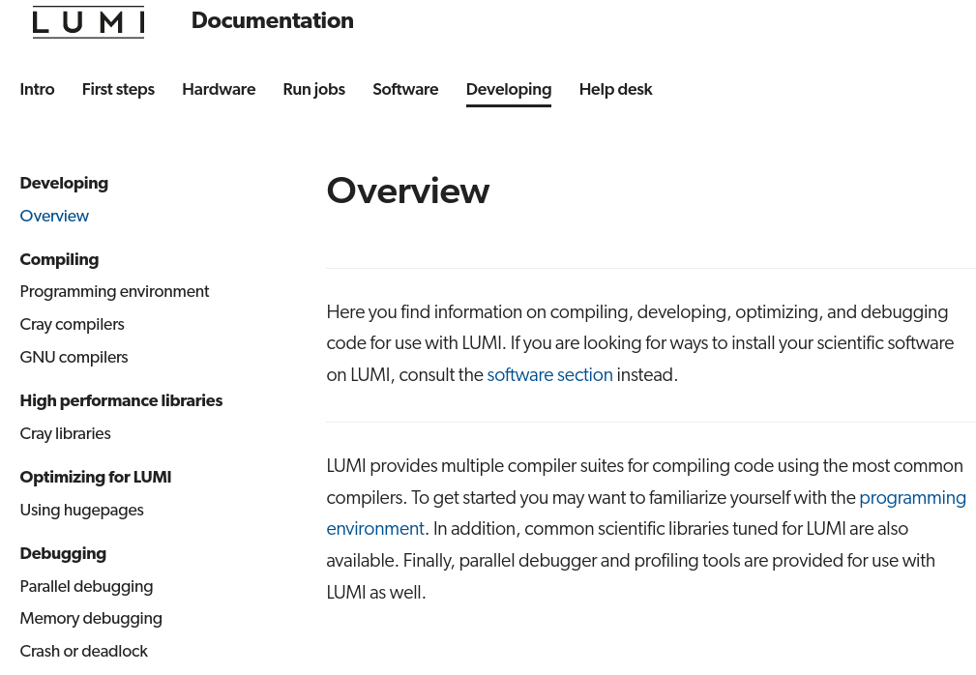
LUMI computing environment
The LUMI software stacks contain the software that are already installed on LUMI
    CrayEnv offers the Cray Programming Environment (PE)
    LUMI is an extensible software stack that is mostly managed through EasyBuild.
    Local software stack for local organizations to manage their own software installation
https://docs.lumi-supercomputer.eu/software/
https://docs.lumi-supercomputer.eu/development/

Slide 9
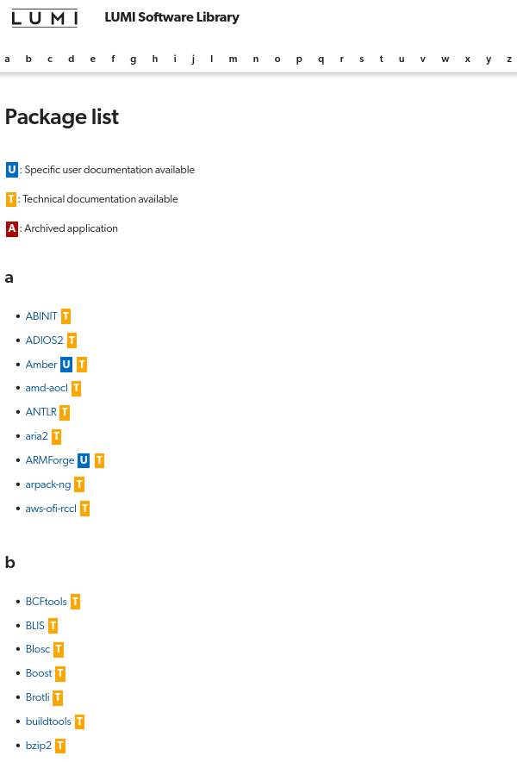
LUMI software library
  https://lumi-supercomputer.github.io/LUMI-EasyBuild-docs/

Slide 10
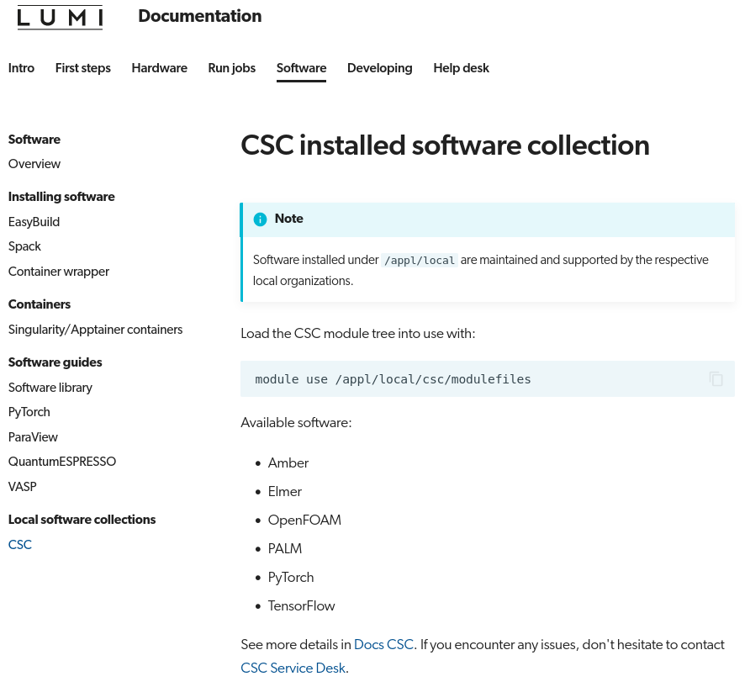
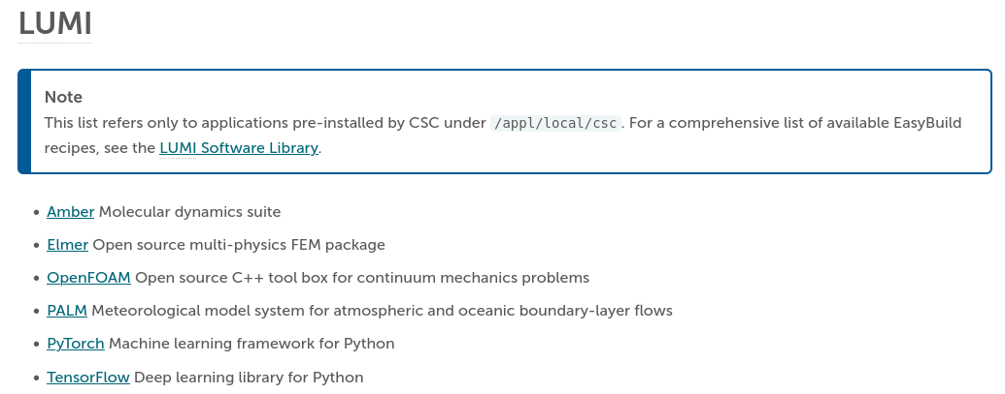
CSC installed software collection on LUMI
  https://docs.lumi-supercomputer.eu/software/local/csc/
  https://docs.csc.fi/apps/by_system/#lumi

Slide 11
LUST – a unique user support team in high-performance computing
Trainings
Porting program
Help desk from Monday to Friday 9-19 EET

